Slide 1
Transformation Management Office (TMO) for Financial & Business Transformation of Damodar Valley Corporation (DVC) GEM ID: GEM/2024/B/5386233 Approach & Methodology - Technical Presentation
Private and Confidential May 2025
© Deloitte Touche Tohmatsu India LLP

Slide 2

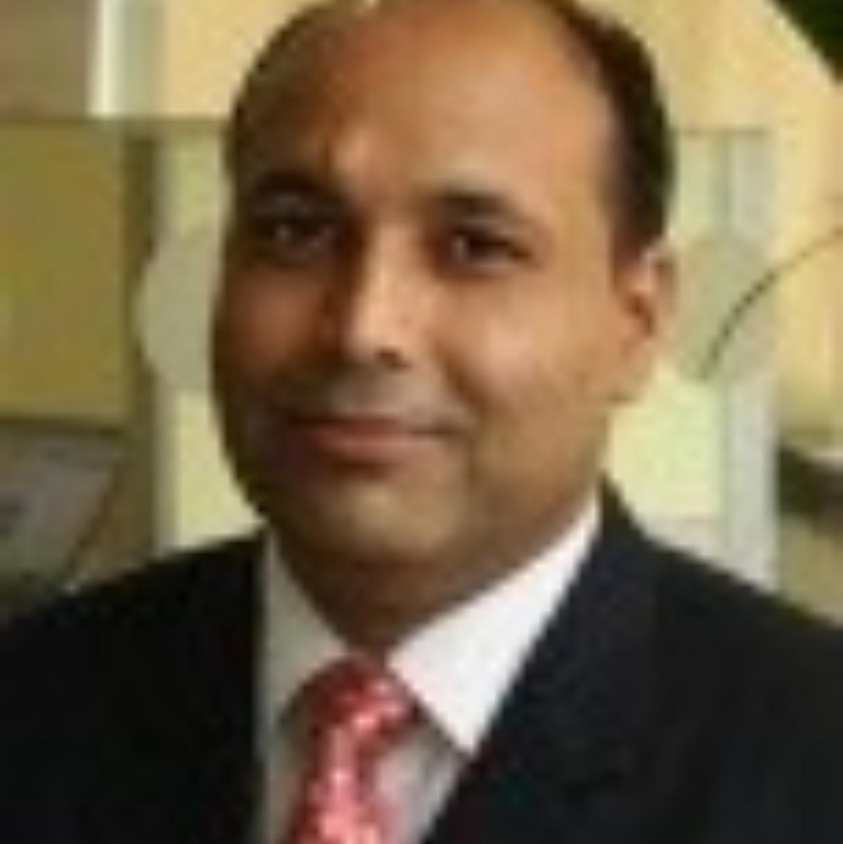

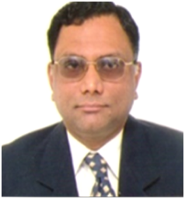
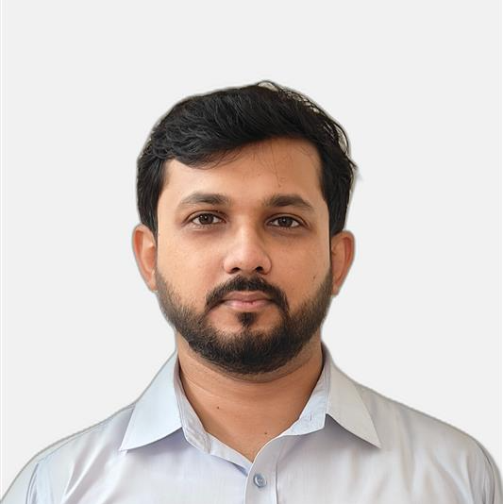

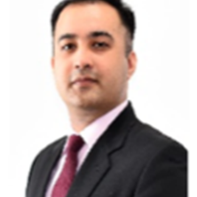
With You Today!
Project Leadership
Shubhranshu Patnaik
GPS Leader
Kushal Kumar Singh
Transaction and PPP leader
Samrat Roy
Financial Restructuring Plan Specialist
P. Hariharan
Financial Management Specialist
Project Team
Samrat Roy
Team Leader and Financial Expert
Shouvik Mukherjee
Business Plan and Financial Modelling Expert
Shib Sankar Saha
Finance Specialist/ Valuation Expert
Siddharth Mani
PPP Expert
Home Office Support to the Key Experts
Project Monitoring and Evaluation
Project Quality Assurance
Contract Management
Admin and Logistics

Slide 3
Content
Understanding of the Objectives
Approach and Methodology
Work Plan

Slide 4

01
Understanding of the Objectives

Slide 5


Damodar Valley Corporation (DVC) — a towering legacy!
1
Objective and Strategic Context
2
3
DVC is a key power sector player in Eastern India - driving growth, transforming lives & communities. Its remarkable turnaround over past few years offers an opportunity to drive growth, strategic transformation, operational efficiency, resilience and sustainability.
DVC at a Glance
Achievements & Accolades
Turnaround Story
In INR Cr.
Powerhouse of Eastern India
6,701 MW generation capacity with an expansive Transmission network
Highest generation of 44.31 BUs & highest PLF of 76.81% in FY 24.
99.8% system availability in FY 24.
DVC Bonds are rated AAA – Highest rating by agencies
Consistently amongst top 10 Central Sector TPSs based on monthly PLF
“Future- Ready Inclusive Organization” amongst PSUs.
Awards for Excellence in Energy Management and Ash Handling.
Best Performing CPSU in Electronic Procurement.
Attained globally acclaimed ISO/IEC 27001:2022 certification.
Decade of growth and financial turnaround
Economic Catalyst
Amongst the largest power sector entities in the country
811 (3.2%)
FY14
-995 (-8.1%)
FY24
Total Revenue
Profit After Tax (PAT Margin)
Social Capital
5000+ Direct and 20000+ Indirect employment
Net Increase/(Decrease) in Cash Generation
FY14
Driving Agriculture
Irrigating ~4,16,000 Hectares
FY24
Asset Utilization & Return on Capital
Flood Control
Enables Flood Control for Jharkhand and West Bengal
52.8%
23.9%
9.9%
3.1%
FY14
FY24
Asset Turnover Ratio
Return on Capital Employed
Notes:
Socio-economic-commercial organisation helping Easter region primarily and nation at large. Proud org, with lot of achievements over the years, but lot of accolades during recent years and the org transform itself in areas of generation PLF, Transmission availability, internal efficiency, high bond rated transiting to one of best psu.
But most importantly, the turnaround story of DVC over the last 4-5 years after years of being in red. Doubling revenue, improving operational and commercial efficiency, improving financially with cash covers providing confidence to its stakeholder for the vision it has.
6700 MW of total installed capacity (Excluding JVs)
Source for financial ratios – DVC Annual Reports for FY 2014-15 and FY 2023-24

Slide 6
Future Agenda: Plan to double capacity by 2030 with modernized & sustainable Ops
1
Objective and Strategic Context
2
3
With an aspiration of 15GW installed base by 2030, requiring ~₹60,000 Cr. in investments, DVC’s focus is on driving Future of Energy, operational excellence, financial resilience and a sought-after work environment.
Growth Aspirations (Capital Expenditure Plan)
In INR Cr.
3,970
Capacity Augmentation
Value Enhancement and Improved Profitability
Decarbonization & Alignment with Future of Energy
Unlock Value through PPPs & Monetization
Efficient Resource Mobilization – Debt and Equity
Optimize capital costs and RoCE
Thermal
Solar
PSP
BESS
T&D
Others (FGD, Regular Capex)
Total
Energy Transition
(1500 MW Solar, 2500 MW PSP and 500 MWh BESS capacity addition underway)
Sustainable
Growth
(3,720 MW of thermal capacity, New Mines)
Technology Diversification and Modernization
Operational Excellence through Transformation
Adopt best practice in Risk Management and Controls
Margin
Improvement
(Optimizing Revenue Collection and Financing)
Business
Excellence
(ERP, workshops
& conducive HR Policies)
Foundational Asset Management practices
Efficient project management and monitoring
Capacity Building of staff on areas outlined
Notes:
DVC vision include to be a leader in power sector and to abide by the promises it has by mandate. One of the talked about aspirations to be become a 15GW +
Doubling capacity 15GW, staying profitable both and cash to investment, Doubling the asset base 65k to another 65k. You also have a ancillary targets like Decarbonization goals
company keeping other mandates like decarb (so its portfolio to be green at least by 25%), sustainable growth with margins improved and most importantly efficient and effective company.
Strategy – Value unlock and enhancement; Top line improvement; Profitable; Capacity augmentation; Resource mobilization; Risk and control
Growth, decarb, cash, regulatory, JSERC, old assets
Source:
https://energy.economictimes.indiatimes.com/news/renewable/dvc-to-invest-rs-20000-cr-in-solar-energy-projects-by-2030/111528325 (Solar Investment)
CARE Ratings Press Release for Damodar Valley Corporation dated 13th January 2025 (Thermal and PSP investment)
https://renewablewatch.in/2025/04/22/damodar-valley-corporation-ambitious-thermal-and-renewable-energy-expansion-plans/ (T&D network expansion)

Slide 7
Unlocking Growth - Strategic Segmentation of DVC’s Diverse Business Portfolio
1
Objective and Strategic Context
2
3
Thematic opportunities for business expansion leading to long term growth, sustainability and profit maximization
Segmentation at DVC
Generation
Transmission
Distribution
Mining
Irrigation / Water Supply
Flood Control
Tourism
Land & Water Bodies
Installed Capacity - 8,089 MW
~7084
~1549
6Mn
1.5Bn
147m
04
91k/
0.95Mn
Thermal
147
14
Hydel
Reservoir Level- Above conservation level - Maithon
Solar
ckt Km
>132 KV levels
ckt Km
33/11 KV levels
Annual peak coal production capacity
Cubic Meter
Water Allocation
Dams (Maithon, Panchet, Konar, and Tilaiya)
Land Area (Acres)/
flood reserve capacity (acre feet)
JV
Indicative set of identified special projects to support DVC’s vision; Best suited projects to be identified using funneling approach
CORE
DIVERSIFICATION / RENEWABLES
STRATEGIC INITATIVES
ENVIRONMENT
OTHERS
Thermal Expansion
Geographical Expansion
Alternate
Energy
Pumped Storage
Smart Grid,
IT/OT Interventions
Soil
Conservation
Industrial Water
Renovation & Modernization
Capacity Augmentation
Floating Solar
Nuclear, Green Hydrogen
Cost Optimization
Fish Farming
Business Outsourcing
11kV/LT Expansion
New Mine Acquisition
Commercial Mining
Solar Irrigation
Efficiency Improvement
Capacity Building; Compliances – FGD, Fly Ash Utilization, Biomass Co-firing
Source – DVC Annual Report 2023-24; Official Website
Notes:
lets deep dive into details of DVC business segments.
Imp to structure re structure, may be break down core, non core, power non power, new and old business and reflect on various initiatives undertaken
G…….., T…………….., D……………., Mining………….., Irrigation…., FC…., Tourism, Land and water bodies..
leading to diversification into new technology (RE, BESS, Pump hydro), We are talking about investment into aged transmission assets, we are talking about expanding to LT on the distribution side, …………………………….
Question here is – all business together can it create investment potential of 18k cr i.e 30% of funds, if not how do we unlock value and or enhance business value
lets evaluate

Slide 8

Options & Instruments Evaluation for DVC
1
Objective and Strategic Context
2
3
Adopting funneling approach across boundary conditions to evaluate available possible instruments and options
Options and Instruments
1
SPECIAL PROJECTS
2
Joint Venture
DVC Holding IPO
New Energy IPO
New Energy PPPs
DVC-CPSE Discom JV
DVC Transco AOMT
Shared Services Units
DVC Bengal Discom
DVC J’khand Discom
Tourism Management Contract(s)
Asset/Land Monetization
Energy Transition Services for C&I
3
PPP
STRATEGICALLY SOUND
ILLUSTRATIVE
4
AOMT
REGULATIONS
COMPLIANT
5
InVIT
SELF
SUSTAINABLE
VALUE CREATION
Asset and Land Monetization
PROFITABLE
Water Rights
Tourism Outsourcing
O&M – F , EPC-F
Distribution Franchise
BOUNDARY CONDITIONS
THE DVC ACT 1948
GEOGRAPHICAL BOUNDARIES
OWNER’S BUY-IN
ROI Securitization
Green Bonds, IPO, DFI’s
MULTI-REGULATORY ENVIRONMENT
EMPLOYEES’ BUY-IN
Notes:
Taking into account all the business segments, we evaluate the options and instruments available; the boundary conditions, we will narrow it down to 4-5 potential options for DVC as part of our engagement. explain

Slide 9

Financial & Business Transformation - Scope & Outcomes
1
Objective and Strategic Context
2
3
Strategic business decision making, effective financial management and process excels fuel DVC’s efficiency and profitability
Key objectives, tasks and expected outcomes for DVC’s transformation as a leading utility in the country
KEY PROJECT TASKS
EXPECTED OUTCOMES
A
Financial Restructuring Plan
FINANCIAL RESTRUCTURING PLAN
Organization Ready for Restructuring
Improved Financial Accountability
ASSET MANAGEMENT
B
Financial Management Assistance
C
Finance and Resource Support
D
Advisory Support for Asset Management via Fixed Asset Creation
Improved Operational Efficiency
Leverage Private Sector Capital
REVENUE AUGMENTATION & INVESTMENT MONITORING
FINANCIAL MANAGEMENT AND RESOURCE SUPPORT
E
Alternate Revenue Augmentation,
PPP Projects
F
Special project / investments monitoring
Embark Energy Transition Path
Better Asset Managed Utility
“Pivotal engagement to support DVC’s overarching vision on capacity expansion, improved financial performance,
energy transition and regulatory compliances”
Notes:
Explaining the objective and thematic task as per ToR, perfectly designed to align with the objective

Slide 10
02
Approach & Methodology

Slide 11
Finance and Resource Support
1
2
Approach & Methodology
3
T A S K
A
B
C
D
E
F
Objective - Finance and Resource Support
DVC aims to develop a comprehensive financial management strategy that enhances the financial strength of its business units through newer financing instruments. Goal is to have an updated financing roadmap and model, with alternative sources of financing that DVC can readily implement.
Evaluation of prior financing roadmap and recommendation for similar future strategy
Assess newer financing options and the compliances required by DVC for using them
Pro-con analysis of each financing option, along with strategy and model for phased implementation
Implementation support and stakeholder coordination
Task description
01
02
03
04
Expected outcomes
Updated financing roadmap
List of options that DVC can explore for augmenting revenues
Updated implementation strategy for DVC
Continuous management support and socialization of DVC’s strategy
We will engage in the Strategy & Ideation phase with DVC management and key stakeholders to understand their vision, strategic priorities, and long-term aspirations

Slide 12
Finance and Resource Support
1
2
Approach & Methodology
3
T A S K
A
B
C
D
E
F
Presently DVC uses relatively traditional methods of financing. The latest financing roadmap for DVC explores newer modes of financing. Under this task, we shall review these plans and seek areas of upgrade.
Review of existing financing plan and analysis of newer options
Review present financing mechanisms used by DVC
Secured and unsecured bonds
Terms loans from banks and financial institutions
Loan from Government of India
Equity
Revised financing plan
Review newer financing options in DVC’s latest financing roadmap
Refinancing of bonds
Securitization of cash flows
Stake sale in JVs
Funding support from multi-laterals
Monetization through InvIT
Monetization of Land Banks
Corporatization leading to IPO
Revision of financing roadmap: Discussion with DVC on the newer models, compliance considerations and changes in policy. Revision and updation of financing plan and model accordingly.
Finalization of the financial model, including phasing of implementation: above analysis shall take into consideration phasing of financing options depending on the nature of respective assets/projects.
Exploring other financing modes
Exploring DVC’s projects and asset register for other modes of innovative financing and monetization.
E.g. OMDA model for mining projects.

Slide 13
Alternate Revenue Augmentation, PPP Projects
1
2
Approach & Methodology
3
T A S K
A
B
C
D
E
F
Objective - Alternate Revenue Augmentation, PPP Projects
DVC aims to leverage the PPP model to develop projects that optimally utilize private sector expertise and resources. This shall develop capacity in the line departments of implementation of the PPP model across sectors.
Task description
Expected outcomes
Develop PPP project structure across sectors (infrastructure, power, water etc.)
Market sounding of PPP projects
Support line departments in developing transaction plan, review of documents including Concession Agreement and bid process management (if required)
Case for VGF: review of project model and documents and support in preparation of case for VGF
Collection of data from line departments regarding ongoing PPP projects and preparation of monitoring and reporting mechanism
Support DVC in obtaining Central and State Government (West Bengal, Jharkhand) support for project development funding
Soundly structured projects to help smooth and timely execution
Knowledge about the interest level in the market and related expectations
Uniformity in assumptions, structures, bid documents across implementing agencies
Possible additional support for PPP projects in the form of VGF
Project management: monitoring execution of PPP projects throughout the project lifecycle
Possible Central/State level funding support to projects; regular progress updates to stakeholders to mitigate any potential risks or delays
1
2
3
4
5
6
We shall request DVC for information on ongoing and pipeline PPP projects, along with points of contacts in line departments.

Slide 14










Alternate Revenue Augmentation, PPP Projects
1
2
Approach & Methodology
3
T A S K
A
B
C
D
E
F
Usage of PPP and other forms of private sector participation in DVC projects can be increased through effective structuring and market sounding. This task focuses on assisting implementing agencies undertake the same.
Support line departments in below stages of the PPP transaction advisory lifecycle…
Stage 03: Activities Post Identification & Pre-feasibility
Stage 08: Pre-procurement Activities
Stage 10: PPP Contract Signing
Stage 01: Project Identification
Stage 06: Bid Documentation
PPP transaction advisory lifecycle
Stage 09: Bid Process Management
Stage 07: PPP Project Appraisal & Approval, including VGF
Stage 02: Pre-feasibility Studies
Stage 04: Project Feasibility Assessment
Stage 05: Project Structuring
Initial structuring of projects, followed by identification of relevant investors, preparing marketing collateral and meeting potential developers/investors to market test projects shall also be undertaken. Further, status updates on ongoing PPP projects shall be collected, recorded and presented to DVC periodically.

Slide 15
Monetization example: land parcel based monetization
1
2
Approach & Methodology
3
T A S K
A
B
C
D
E
F
DVC may monetize its suitable land parcels in Jharkhand and West Bengal as an additional and alternative source of revenue.
Damodar Valley Corporation (DVC)
Authority
Possible support required from DVC
Capital support/grant for development of common infrastructure facilities and provisions for operational grant to the developer and subsidy to the end users
Development on PPP mode
Broad PPP structures for development
PPP Partnership through Concession
Strategic Partnership through Equity
Sale of land right with Private Entity
No right of Sale of land with Private Entity
Majority Stake with DVC
Minority Stake with DVC
Project structuring
Development of pharma, bulk drug park, chemical and bio-tech park by Maharashtra Industrial Development Corporation (MIDC)
Deloitte explored various land-based PPP options for development of the Bulk Drug Park in the Dighi Port Industrial area of Maharashtra. We developed a detailed techno-economic feasibility study of the project, followed by project structuring and bid process management.

Slide 16




Monetization example: Toll-Operate-Transfer (TOT) PPP projects
1
2
Approach & Methodology
3
T A S K
A
B
C
D
E
F
Pool of operational toll roads
Applicability
Benefits
Road Assets
Revenue generating brownfield assets under operation and maintenance.
Prevalent in Roads and Highways projects
Easy contract management
Proceeds from upfront premium may be utilized to fund greenfield projects
Enhanced operational efficiency
Allows bundling of assets to garner investors interest
TOT Concession Contract
Private SPV
O&M Partner
Upfront Concession Fee
O&M Contract
Concessionaire
Equity
Debt
Key Challenges
Considerable revenue and demand risk involved for the Concessionaire.
TOT projects may find it difficult to tie-up debt
Lack of large-scale investor participation vis a vis INVITs
Shareholders
Lenders
NHAI’s experience with TOT
Pioneer in asset monetization in India. First central government entity to adopt the concession-based TOT approach to monetize its asset base. Since 2018, NHAI has monetized 6 bundles to raise proceeds of over INR 26,000 Cr.
Transaction Structuring: asset selection, bundling key reasons for tepid investor response on NHAI’s TOT 2 and TOT 4 bundles, which were eventually shelved
Use of Proceeds: going forward, the TOT model is expected to play an important role in NHAI’s asset monetization strategy. NHAI may use proceeds for future capital expenditure into greenfield assets that may eventually be monetized through another TOT concession after COD.

Slide 17
Monetization example: Investment Trusts (InvITs)
1
2
Approach & Methodology
3
T A S K
A
B
C
D
E
F
Appoints
MODEL CHARACTERISTICS | MODEL CHARACTERISTICS:
A trust registered with SEBI, a financial instrument which attracts long-term investors
Key Requirement | Operational Infrastructure assets, with at least 1 year of operations for Public InvIT
Key Challenges | Complicated structure: weighty regulations and guidelines applicable Challenges for investors: possibility of unpredictable cash flows, limited investment choices and low liquidity
Types of InvITs | Public: Open for participation by all kinds of investors including retail Private: Restricted for participation by Qualified Institutional Buyers & bodies corporate
Applicability | Eligible sub-sectors as per Harmonized Master list of infrastructure sub-sectors of MoF
Minimum Value | Assets under InvIT: INR 500 Cr (Initial Offer Price: At least INR 250 Cr)
Consideration | Upfront Consideration against subscription of InvIT units
Investor Class | Financial investors looking for stable yields; sovereign wealth funds and global pension funds, insurance funds, retail investors etc.
Governing Guidelines | Notified by SEBI on September 26, 2014 (amended from time to time)
Investors (Resident / Non-Resident)
Sponsor
Min holding
15% or 25%
SEBI Registered Debenture Trustee
Leverage
up to 49%
Management
services
Lender
(Bank / Institutions)
InvIT
(Trust)
Trustee
Min holding
15% or 25%
Investment
Management
Agreement
Holdco.
Direct acquisition
for Non-PPP Project
SPV
Investment Manager
SPV
Oversight
services
Option 3 - Through Holdco
Option 2 - Direct
Option 1 - Through SPV
Project
Management
Agreement
Project Manager
Project Execution & Management Services
(including O&M Services)
Examples
NHAI InvIT: Rounds (R) R1: November 2021 – fund raise of INR 8,000 Cr R2: October 2022 – fund raise of INR 3,800 Cr R3: March 2024 – fund raise of INR 16,300 Cr R4: March 2025 – fund raise of INR 18,380 Cr

Slide 18
Financial Restructuring Plan (1/2) – Key Imperatives
1
2
Approach & Methodology
3
T A S K
A
B
C
D
E
F
1
Asset Monetization &
Resource Mobilization
Monetization and Mobilization of idle assets (land bank, water bodies, buildings, tourism spots) under PPP to enhance overall profitability
2
Business Hygiene
Asset & cost segregation, G&D losses offset by transmission profits; Unclear division results in common T&D expenditure apportioned in 50:50 ratio; FRP enables cost optimization opportunities
Key Imperatives for Financial Restructuring Plan
3
Statutory & Regulatory
Push from MoP and regulators on DVC restructuring as way of resource mobilizing. Voltage wise record keeping for T&D
4
Corporate Governance & Institutional Capacity
Governance for diversified portfolio and complex stakeholder structure;
modernize management structure; capacity building on focus areas
Business Case - Financial restructuring study by GoWB projected cost reduction in COS by ~61 p/u for WBSEB and ~11 p/u for WBPDCL
JSERC rejects DVC’s business plan for supplying 11kV and below; lack of segregation of account and Non-Tariff Income as key reasons¹
FRP serves as the foundation for Asset Monetization, Resource Mobilization and Cost Optimization at DVC
1 - JSERC Order dated September 30, 2024
Notes:
By now, we spoke about the history of DVC, turnaround, aspirational growth targets, objective of the engagement, instruments and options for resource mobilisaitions.
To implement any of many of the solutions combined, FRP is essential..
For e.g. How do we monetize land or assets by curving out that portion of business. Should we carve out water business for PPP in tourism, can we hive off plants to securitize ROE, how do we curve out value from water rights to co-invest in floating solar are few of the debates we have.
Apart from FRP, it is also essential to understand how we run and report our various business segment, way we allocate cost and revenue, is there any cross subsiding happening around. Water to power and within power?
Are the allocating and apportionment proper to the satisfaction of regulators. We understand JSERC has been requesting few segregated data.
We also understand MoP has talked about the restructuring of businesses
Lastly SBU way of organizing business is always advisable to focus on business, institutionally and by way governance.

Slide 19







Financial Restructuring Plan (2/2) – Execution Approach
1
2
Approach & Methodology
3
T A S K
A
B
C
D
E
F
Anticipated Challenges
Execution Approach
Preferred unbundling option? Power & Non-Power? or any other?
Cost Segregation – Allocation and Apportionment
 | Discuss unbundling options – Power Vs Non-Power, Conventional Vs RE, others
 | Evaluation framework (profitability, sustainability, other factors)
 | Financial models and sensitivity analysis for next 10 years
 | Selection of best suited unbundling model with cost implications
 | Review of regulatory projections and impact on tariff
 | Policy advocacy with MoP and regulators
 | Strategic areas support – Enablers, Manpower, BPR, etc.
Statutory Positioning (DVC Act, Electricity Act, Companies Act)?
Asset and Liability Attribution Complexity
Thoughts on Ownership Structure (JV, Hold Co., SBU)?
Legal Complexities
The DVC Act 1948, The Electricity Act 2003, The Companies Act 2013
Thoughts on Shared Services?
Regulatory complexities
(CERC, WBERC, JSERC)
Resistance to Change
Data Gaps
Learnings from similar engagements
Notes:
In terms of our approach, elements with restructuring and transfer scheme. Experience sharing 131 (1,2) and 131 (4) 1st phase and 2nd phase of EA act, drafting the Transfer scheme. Working for largest discom some pointers, also cross industry CIL, xxxx, SA region,
Based on various experience – challenges
Steps and debates and ideating
Model viability, impact on revenue, on cost of supply, allocations

Slide 20
Advisory Support for Asset Management via creation of Fixed Asset Register (1/2)
1
2
Approach & Methodology
3
T A S K
A
B
C
D
E
F
1
Key element of Financial Restructuring Plan(FRP)
Mapping assets with aligned businesses to ensure correct allocation during FRP, form basis of equity division and depreciation allocation. Physical Verification required to create audit trail of asset handover
2
Substantial asset addition
Capex infusion of INR 65,000crores¹ in next 10 years, nearly same to the existing gross asset base of approx. INR 68000 crores² as on FY 24.
Key Imperatives for Asset Management
3
Statutory & Regulatory
Audit noting on location of assets. Push from MoP and regulators on asset segregation to promote transparency in cost allocation and accurate tariff determination.
4
Asset Hygiene
Asset conversion, utilization and retirement post exhausting useful life and are not serviceable, CWIP of nearly INR 5,200 crores³ as on 2023-24 to be converted into assets.
DVC’s new-age generation will require skill sets/capacity for efficient asset monitoring
DVC is currently
implementing Ind AS
Asset segregation and valuation can be a pre-requisite for restructuring and resource mobilization initiatives
Completion of Asset Segregation will form the basis for any restructuring initiatives to be taken by DVC
1:SBICaps Report 2,3:DVC Annual Report 2023-24
Notes:
One of the major element of FRP is Asset segregation.
Indian restructuring experience and asset management (ERP, WBSEDCL, WBSETCL, double security) why it is critical for Business. Goes without saying its business hygiene. In fact GERC.
For DVC specifically, FRP requires segregation, doubling asset base in a short span, proper asset management is crucial.
We understand auditor and regulator had commented abt locations of asset in the FAR. You are implementing InsAS where componentization is required.
The ERP is being implemented and draft of asset master and recon of all assets to its value is required

Slide 21
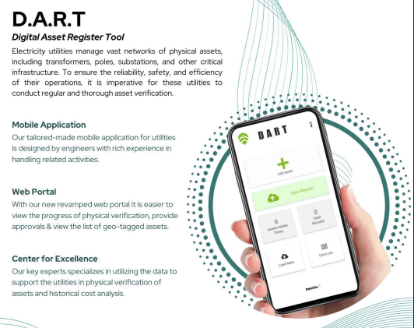


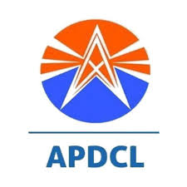

1
2
Approach & Methodology
3
T A S K
A
B
C
D
E
F
Advisory Support for Asset Management via creation of Fixed Asset Register (2/2)
Deloitte has successfully prepared Asset Register for multiple power and other utilities. Our Technology centric approach and tools perfectly positions us to fulfill task requirements
Anticipated Challenges
Our Asset Register Tool
Expected Outcomes
Vast spread of assets, extensive asset type, access and approach
Physical Verification plans and protocols
Weather conditions hamper progress of physical verification especially Transmission assets
Asset Register Tool with asset componentization as per Ind AS
Historical cost data and documentation for old assets may be unavailable
Review and Monitoring of Physical Verification by third party agency
Fund source identification can be a challenge
Our Experience
Compilation of Fixed Asset register with full details of asset location, cost, balance life and condition
Agency familiarity, capacity and work methods will be critical
Asset Management framework for continued monitoring
JBVNL
NEA
Asset Register with segregation will be the basis for any restructuring initiative
Notes:
Our approach for creating of FAR will be digital, in fact we have a home-grown solution (portal and app) developed by team of CA, Engineers and Tech team. We have implemented for NEA (funded by WB), WBSETCL (to replace existing FAR in SAP), APDCL (integrated with GIS), JH (T&D), Maldives. And solution is industry agnostic (water, O&G, telecom). Because of our experience in implementing in Indian utilities, we understand challenges like, delays in mobilizing surveys, some beyond our control, lack of proper records to reconciles, some time schedule mismatch with utility ground team, delays in step approvals (we have 2-3 levels of approvals) before we finalize.
Because we have implemented in several clients, we have templatized the steps and solutions. Here we will select set up a PMO, run bids for survey team, develop the survey plan, monitor the PV and data collection, sanitise the data. Post which we will start recons with your data and complete the registry. Post which we will handhold your team to take the exercise forward over the period of engagement as this is a ongoing task.

Slide 22
1
2
Approach & Methodology
3
T A S K
A
B
C
D
E
F
Special Project / Investments Monitoring (1/2)
1
Planning and financing
Defining scope, setting up practical timelines, arranging finances at low cost, steady equity requirement
2
Documentation
Multiple contract, different project lifecycles, DVCs aspiration for renewables, comprehensive task allocations for project objectives.
Key Imperatives Project Management and Investment Monitoring
3
Statutory & Regulatory
Environmental clearances, Pollution control, Land Acquisition. CAPEX approved through regulators
4
Reporting and Data
Design and Implementation, time and cost optimization, information flow in digitized environment
Regulatory disallowances of CAPEX
impacts growth and profitability objectives (JSERC rejection of 11kV CAPEX plan)
Shortfall of INR 337 crores¹ in CAPEX targets due to non finalization of tender on time
20 projects closed² out of 25 scheduled for closure in FY 2023-24
Implementation of Project Management and monitoring Investments plays a pivotal role in DVC’s aspirations
1,2: DVC Annual Report 2023-24
Notes:
Task F, its all about monitoring the agreed projects. Planning is done by now and what’s is most critical is execution and we hear what CMD sir spoke about in his first podcast – execution, execution and execution. That’s where the monitoring is so critical.
Good point abt this rfp n linkage.
Monitoring 60k cr of capex requires additional support and experts as we diversify into alternate energy as well.. Lenders, Investors and regulators are eyeing on it. We have history of few slippages impacting regulatory disallowances. Cant risk this time, so areas like documentations, reporting, data collection, real time monitoring needs extra attention.
Also to keep in mind that its not just thermal, lot of new energy tec we are talking abt. Lot of JV, MOU, PPP, lot of things will be happening round

Slide 23
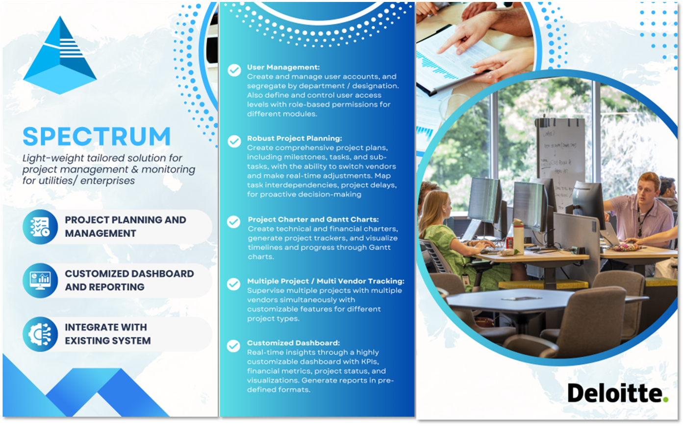
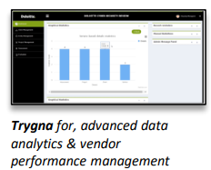
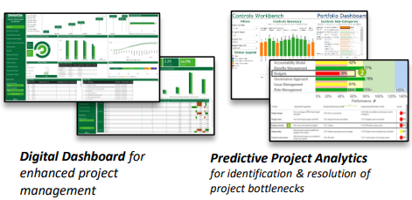




1
2
Approach & Methodology
3
T A S K
A
B
C
D
E
F
Special Project / Investments Monitoring (2/2)
Deloitte has successfully monitored multiple projects cross industry across India and abroad. Proprietary tools and experienced team are our main enablers towards successful Project Management
Anticipated Challenges
Our Approach focuses on
Expected Outcomes
Regulatory and Stakeholder approvals and timelines
People
Schedule
Technology
Financials
Establishment of unified project/scheme reporting framework
Deloitte’s tools and methods
Fund availability across project lifecycle
Project Management Tool for project reporting and monitoring
RoW, R&R issues, dispute resolution
Stakeholder Communication and Cadence
Skill sets/capacity for new-age initiatives
Pro-active identification of project risks
Reporting Capabilities required to preempt challenges
Our Experience
Documentation management and Archival
Notes:
For which we propose use of technology to monitor investments as well as projects. We have lot of tools and solutions across industry to monitor projects. We have a dedicated team specialized on capital project monitoring. We have infact integrated out Asset management solution with project monitoring and implemented in RDSS projects in WBSEDCL. Appreciated by kfW we are implementing for MKVDC in Maharashtra for their solarized lift irrigation project. We plan to utilize the solution while monitoring. We have done for BHEL, Smart conductor mission, RE new and Mining GMDC and O&G. these are all special projects.
All the challenges are mitigated digitally - Managing timelines and schedules, documentations, compliances, variance with budget, inventory recon and reporting
Would like reiterating before I hand over to Hari, that we are brining in strategy expertise, PMC and tech enabled implementation capability.

Slide 24
Financial Management Assistance (1/2)
1
2
Approach & Methodology
3
T A S K
A
B
C
D
E
F
1
Current State Assessment
Financial, Operational and Commercial assessment, assist in opportunity identification
2
Business Expansion
Multi-fold expansion in existing and new business requiring stronger control systems
Key Imperatives Financial Management Assistance
3
Financial Hygiene
Developing Financial Management Frameworks, enhancing/improving internal controls and risk management
4
Planning and Reporting
Assistance in Business Planning, resource allocation, Budgeting, MIS Reporting and Stakeholder Communication
Audit Observations on need to increase internal audit coverage such as operations review, few issues in internal control, physical verification of assets and inventories
Need to transform MIS from record & report into a robust decision support system
With revamped MIS and financial frameworks, Finance will need to add value through identifying cost reduction, revenue enhancement opportunities
DVC will need to transform Finance into a decision support and strategic advisory role to achieve its vision by 2030
1,2: DVC Annual Report 2023-24, 3:SBICaps Report

Slide 25
1
2
Approach & Methodology
3
T A S K
A
B
C
D
E
F
Financial Management Assistance (2/2)
Focus on Financial Controls and Cost Reduction
Focus on CAPEX & OPEX Budgeting resulting in Cost Control
Financial Planning and Control Systems
Financial Controls
Adherence to Company’s Policies
Prevention and detection of Fraud and Errors
Key Revenue Loss Areas
Safeguarding of Assets
Performance Improvement Targets
Expected Outcomes
CAPEX
WBS element wise budget
CAPEX procurement and services budget
CAPEX fund flow
OPEX
Annual budget cycle
Allocation of overheads
Budget control mechanism
Identification and development of new revenue streams
Cost Reduction
Margin Improvement
Strengthened Internal Controls
Financial Policy and Process Framework
.
Internal Audit
Reporting Frameworks
Profit Center
Updated Business Plan
Variance Analysis
Budgeting
Capital Project Disallowances
Working Capital Disallowances
Auxiliary Losses
Cost of Debt
Non-Tariff Income
Revamped MIS & Reporting
Utilize SAP S/4 HANA to aid DVC in cost management and efficiency improvement

Slide 26
03
Work Plan

Slide 27
Work Plan
1
2
3
Project Execution Work Plan
Strategic analysis of objectives
Strategy Phase
Inception
Discovery Phase
Ideation Workshop
Strategy Development
Stakeholder Discussion
Implementation Strategy
Kick Off meeting
Resource mobilisation
PMO at DVC Headquarters
Analysis of existing Business Segments
Quantifying aspirations
Options Analysis
Ideation Workshop with Senior Management
Roadmap Development
Financing Plan and Strategy
Guidance and Feedback
Major decisions documented
Implementation Planning
Resource Mobilization
Annual Strategic Retreat
T-
Refining the strategic roadmap for DVC in the initial phase of engagement (14 weeks)
“Given this assignment’s impact in the transformation journey of DVC, clear strategy must be defined to approach tasks for each objective”

Slide 28

Work Plan
1
2
3
Project Execution Work Plan
Deliverables
Presentation
A structured approach to engaging key stakeholders across the various objectives to achieve desired results
M1 | M2 | M4 | M6 | M8 | M10 | M12 | M14 | M16 | M18 | M20 | M22 | M24 | M26 | M28 | M30 | M32 | M34 | M36
Kick-off, Preliminary Assessment, Ideation
Resource support; PPP and monitoring
Updated Strategic Plan
Strategic Roadmap
Annual Strategic Retreat
Annual Strategic Retreat
Finalize Investment play book for DVC
Investment play book
PPP deal support and bid advisory
Monitoring Projects in implementation & O&M phase
Implementation support and handholding
Financial Restructuring Plan
As-Is assessment – Allocations, A/c ting, Regulatory, Organization
Draft FRP
Financial model and sensitivity analysis for next 10 years
F/Model
Unbundling roadmap, implementation support and handholding
Unbundling roadmap
Implementation support and handholding
Asset Management
Preparation of Physical Verification Plan
PV plan
Agency Selection, Historical Cost determination methodology
Physical verification monitoring
Preparation of FAR with DART Tool with asset updation
Draft FAR
FAR updation and asset updation
Financial Management
Developing FM Framework, Business plan updation, target setting
Risk control review
Efficiency Improvement, Regulatory advocacy, Implementation
Business plan
Assist in MIS redevelopment and update business plans
Regulatory review
KPI review
Monthly review
Monthly review and investment monitoring meeting
*This TMO has linkages to other TMOs and therefore the timelines of the activities may vary

Slide 29
Thank You

Slide 30
Deloitte refers to one or more of Deloitte Touche Tohmatsu Limited, a UK private company limited by guarantee (“DTTL”), its network of member firms, and their related entities. DTTL and each of its member firms are legally separate and independent entities. DTTL (also referred to as “Deloitte Global”) does not provide services to clients. Please see www.deloitte.com/about for a more detailed description of DTTL and its member firms.
This material has been prepared by Deloitte Touche Tohmatsu India LLP (“DTTILLP”), a member of Deloitte Touche Tohmatsu Limited, on a specific request from you and contains proprietary and confidential information. This material may contain information sourced from publicly available information or other third party sources. DTTILLP does not independently verify any such sources and is not responsible for any loss whatsoever caused due to reliance placed on information sourced from such sources. The information contained in this material is intended solely for you. Any disclosure, copying or further distribution of this material or its contents is strictly prohibited.
Nothing in this material creates any contractual relationship between DTTILLP and you. Any mutually binding legal obligations or rights may only be created between you and DTTILLP upon execution of a legally binding contract. By using this material and any information contained in it, the user accepts this entire notice and terms of use.
©2025 Deloitte Touche Tohmatsu India LLP. Member of Deloitte Touche Tohmatsu Limited
Deloitte Touche Tohmatsu India Private Limited (U74140MH199 5PTC093339), a private company limited by shares, was converted into Deloitte Touche Tohmatsu India LLP, a limited liability partnership (LLP Identification No. AAE-8458), with effect from October 1, 2015.

Slide 31
04
Why Deloitte?

Slide 32


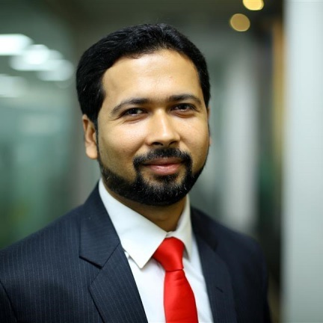








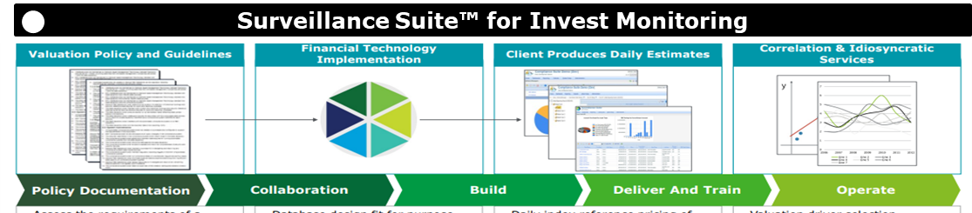





Why Deloitte?
Deloitte has been a trusted advisor for DVC; We bring rich experience in DVC command area with a large regional team
Steady partnership with DVC
Team that understands DVC
Credentials
A/c policies & formats
Raghunathpur revival
ERP Transformation
20+
Projects with central ministries and PSUs.
2004 | 2012 | 2018 | 2018-21 | 2024---
S. Patnaik
GPS Leader
A. Dwivedi
ERI Leader
Kushal Singh
PPP Lead
Samrat Roy
Team Lead
Clientele
The Leadership Team had led the DVC Corporate Plan and Regulatory assignment and currently advising on the ERP transformation
Corporate Plan 2012-22
Regulatory retainers
Deep Regional Understanding
Largest P&U team in the East
Our Accelerators
50+
Resources in West Bengal and Jharkhand working dedicatedly in the East.
50+
Projects with state and private entities in West Bengal and Jharkhand
Power Sector Experts
With 10Y+ experience
Clients served
Clientele
50+
15+
50+
INR 1Cr+ projects (in East)
Country Experience
Transformation projects (in East)
10+
20+
5+
First consultant to be engaged

Slide 33
Summary of Scope of Work
xx
01
PHASE 01
xx
xx
xx
xx
xx
02
PHASE 02
Implementation Support
Note - Detailed Scope of Work to be followed as per the tender document throughout the course of assignment (attached in Annexure)

